Slide 1
Array and vector; Catching Exceptions
C++ How to Program, 10/e

Slide 2
Opening Problem
Read one hundred numbers, compute their average, and find out how many numbers are above the average.

Slide 3
7.1 Introduction
This chapter introduces the topic of data structures—collections of related data items.
We discuss arrays which are fixed-size collections consisting of data items of the same type, and vectors which are collections (also of data items of the same type) that can grow and shrink dynamically at execution time.
Both array and vector are C++ standard library class templates.
We present examples that demonstrate several common array manipulations and introduce exception handling.

Slide 4
7.2 arrays
An array is a contiguous group of memory locations that all have the same type.
To refer to a particular location or element in the array, specify the name of the array and the position number of the particular element.
Figure 7.1 shows an integer array called c.
12 elements.
The position number is more formally called a subscript or index (this number specifies the number of elements from the beginning of the array).
The first element in every array has subscript 0 (zero) and is sometimes called the zeroth element.
The highest subscript in array c is 11, which is 1 less than the number of elements in the array (12).
A subscript must be an integer or integer expression (using any integral type).

Slide 5
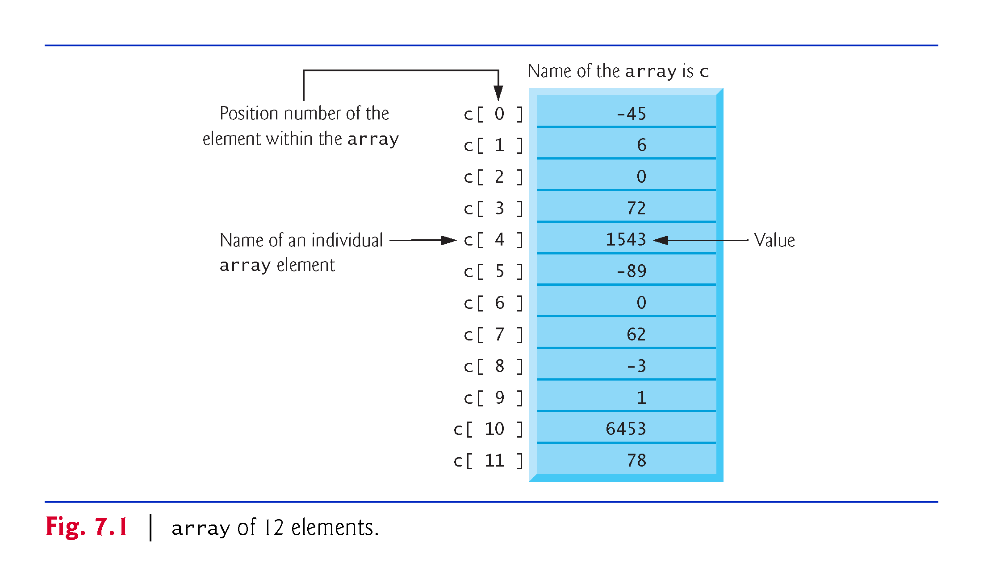

Slide 6
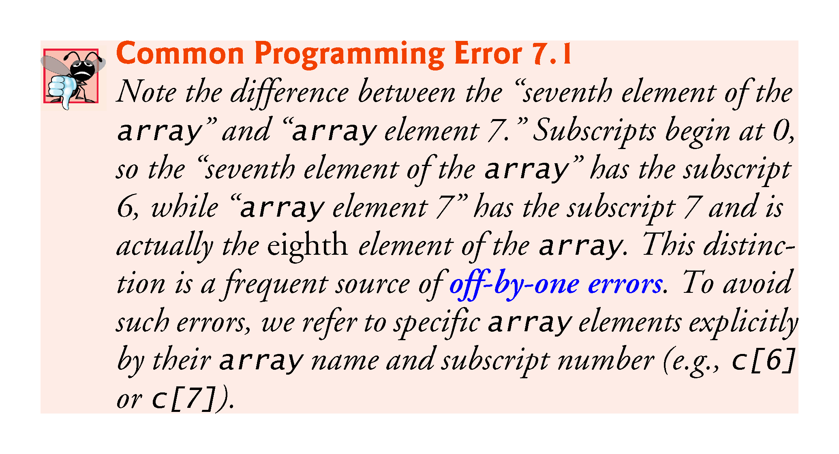

Slide 7
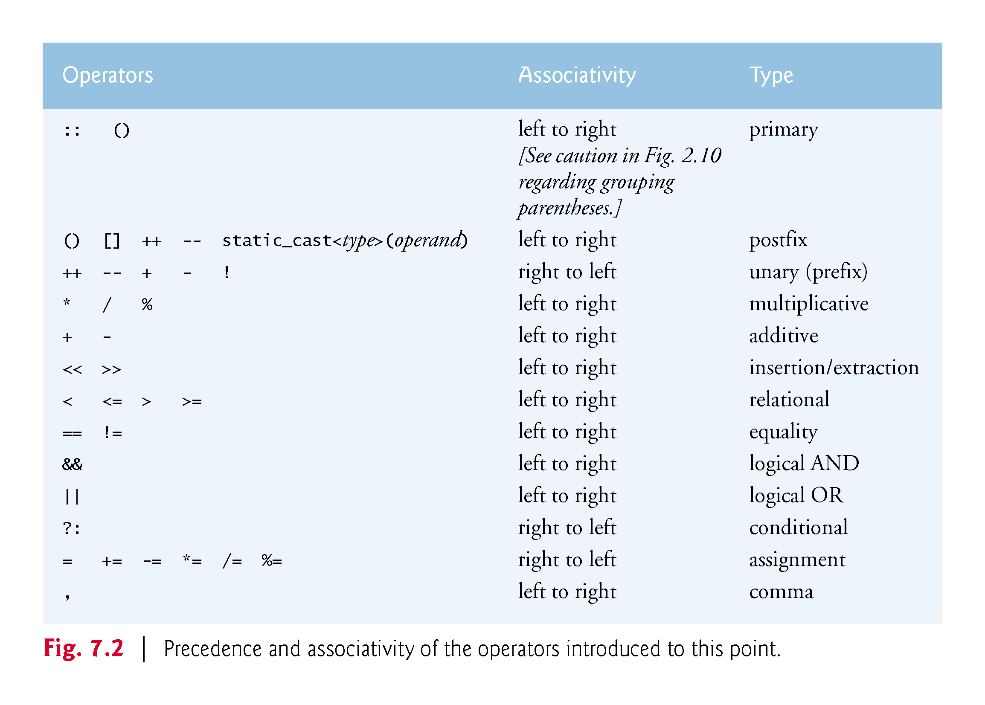

Slide 8
7.3 Declaring arrays
arrays occupy space in memory.
To specify the type of the elements and the number of elements required by an array use a declaration of the form:
array< type, arraySize > arrayName;
The notation <type, arraySize> indicates that array is a class template.
The compiler reserves the appropriate amount of memory based on the type of the elements and the arraySize.
arrays can be declared to contain values of most data types.

Slide 9
Using Indexed Variables
After an array is created, an indexed variable can be used in the same way as a regular variable. For example, the following code adds the value in myList[0] and myList[1] to myList[2].
myList[2] = myList[0] + myList[1];

Slide 10
7.4 Examples Using arrays
The following examples demonstrate how to declare arrays, how to initialize arrays and how to perform common array manipulations.

Slide 11
7.4.1 Declaring an array and Using a Loop to Initialize the array’s Elements
The program in Fig. 7.3 declares five-element integer array n (line 10).
size_t represents an unsigned integral type.
This type is recommended for any variable that represents an array’s size or an array’s subscripts. Type size_t is defined in the std namespace and is in header <cstddef>, which is included by various other headers.
If you attempt to compile a program that uses type size_t and receive errors indicating that it’s not defined, simply include <cstddef> in your program.

Slide 12
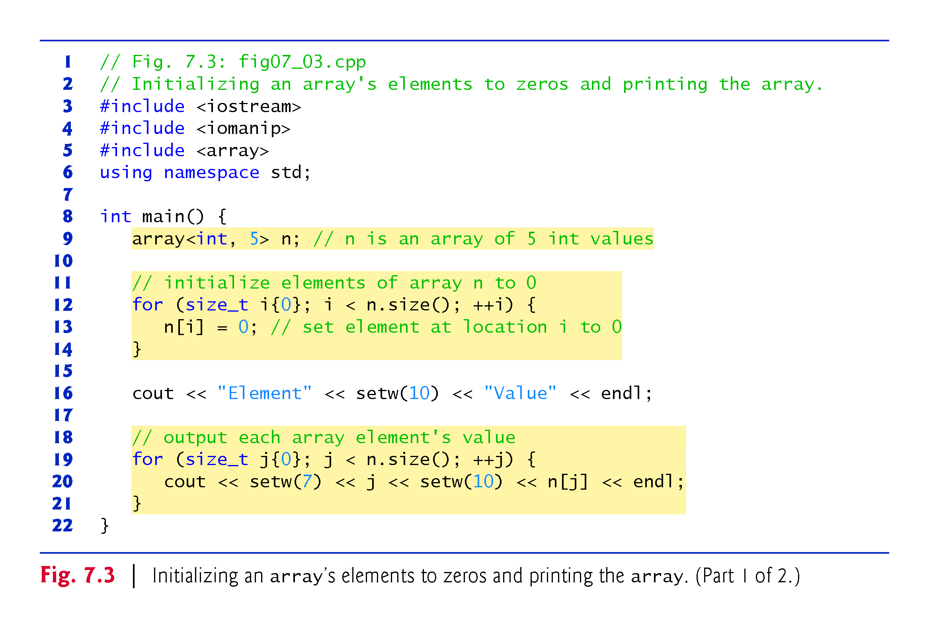

Slide 13
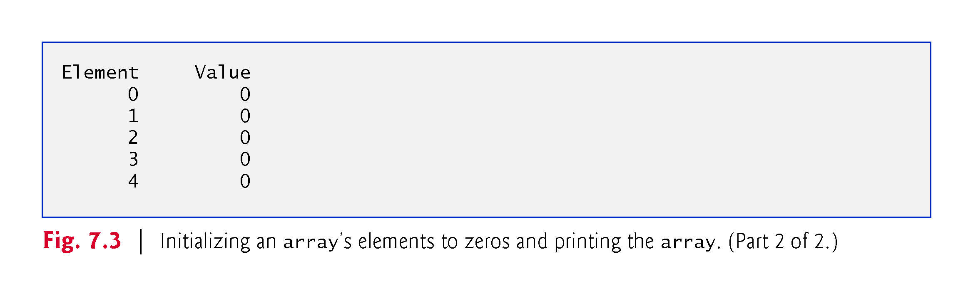

Slide 14
7.4.2 Initializing an array in a Declaration with an Initializer List
The elements of an array also can be initialized in the array declaration by following the array name with an equals sign and a brace-delimited comma-separated list of initializers.
The program in Fig. 7.4 uses an initializer list to initialize an integer array with five values (line 11) and prints the array in tabular format (lines 13–17).
If there are fewer initializers than elements in the array, the remaining array elements are initialized to zero.
If there are more, a compilation error occurs.

Slide 15
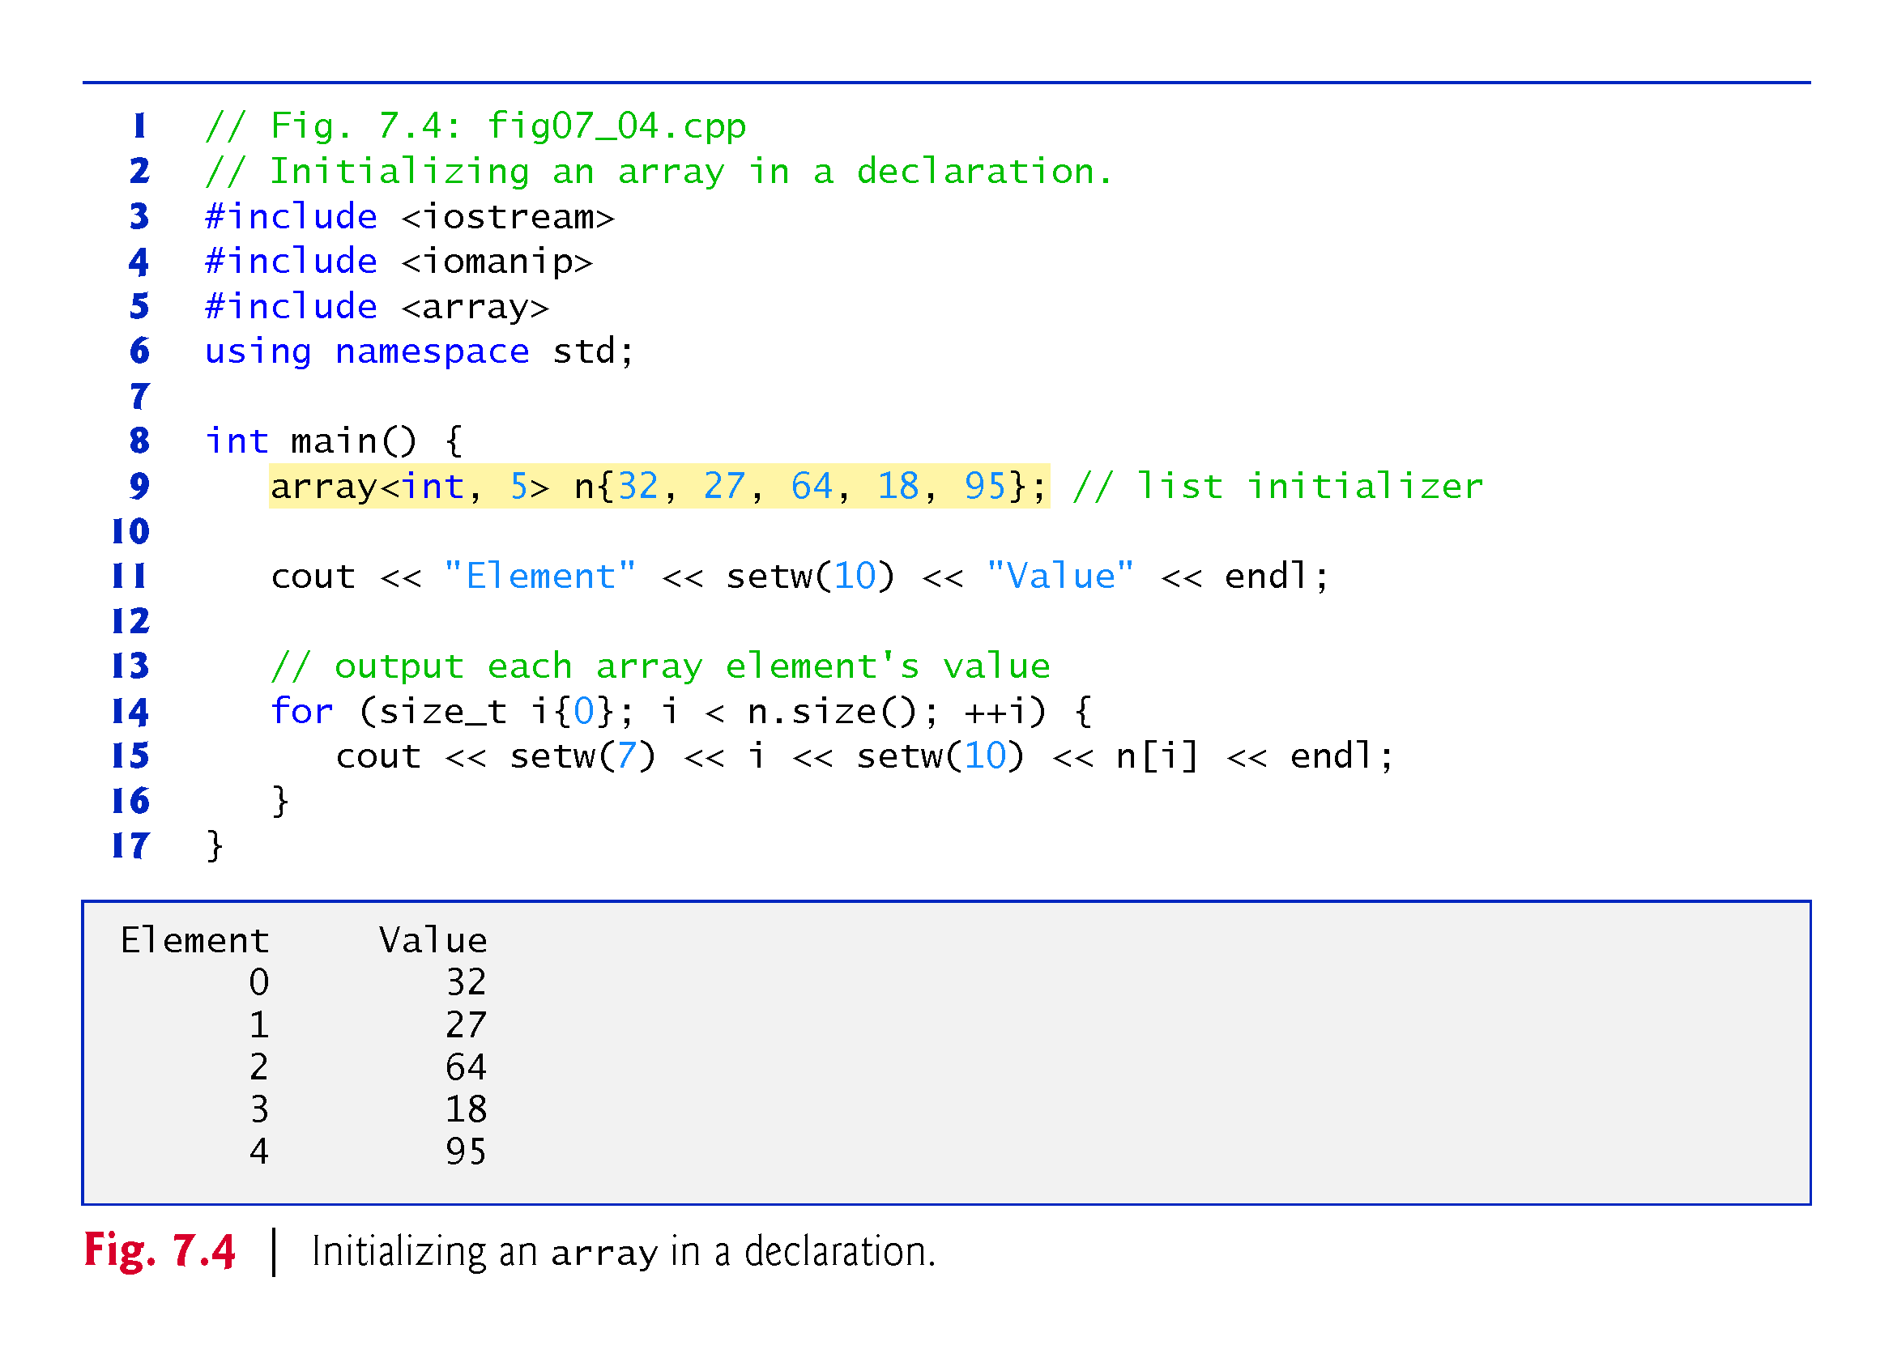

Slide 16
7.4.3 Specifying an array’s Size with a Constant Variable and Setting array Elements with Calculations
Figure 7.5 sets the elements of a 5-element array values to the even integers 2, 4, 6, 8 and 10 and prints the array in tabular format.
Line 10 uses the const qualifier to declare a constant variable arraySize with the value 5.
A constant variable that’s used to specify array’s size must be initialized with a constant expression when it’s declared and cannot be modified thereafter.
Constant variables are also called named constants or read-only variables.

Slide 17
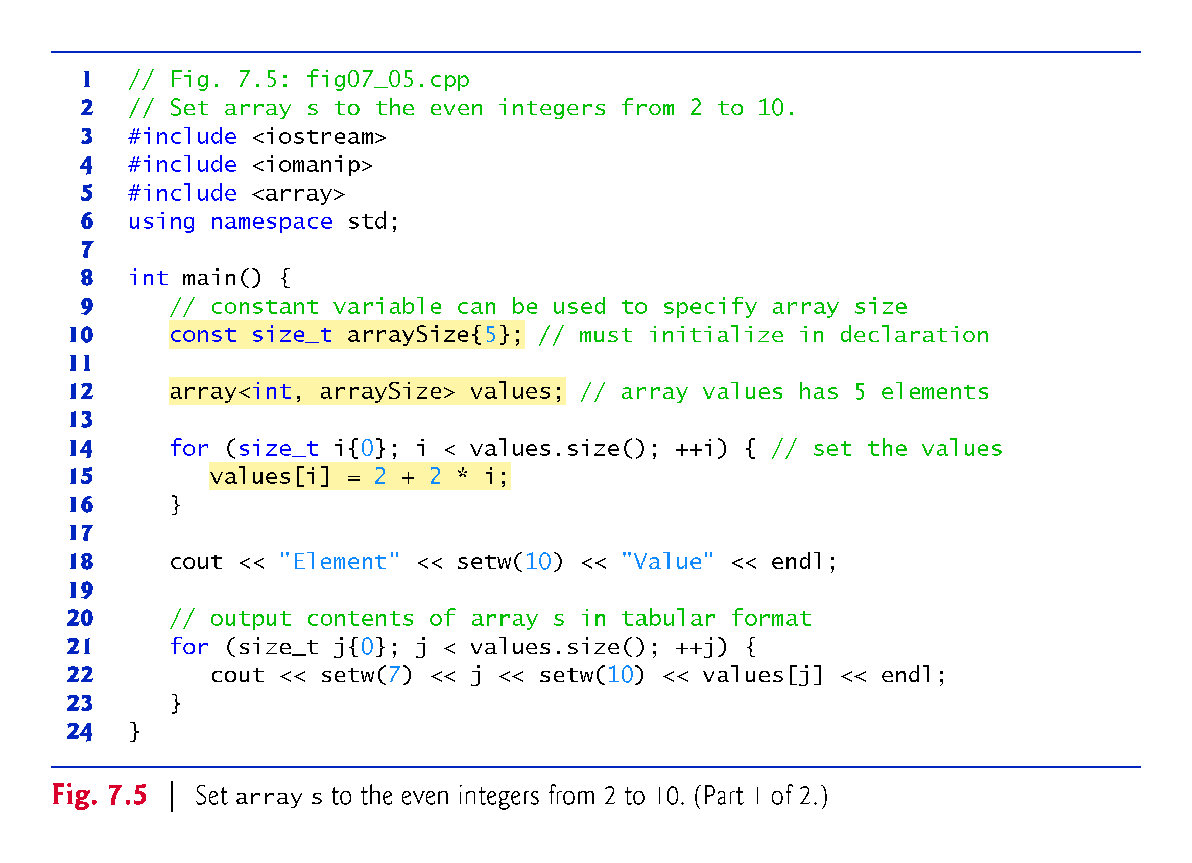

Slide 18
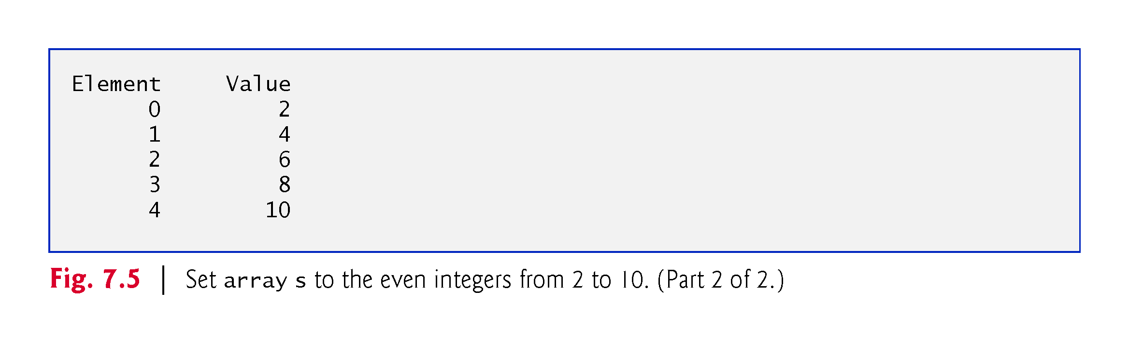

Slide 19
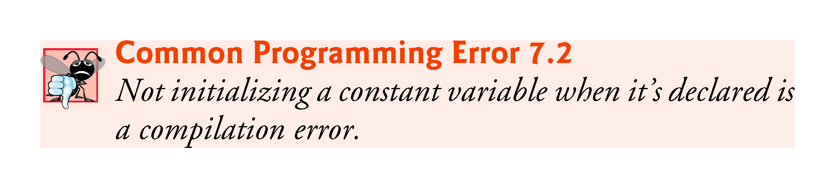

Slide 20
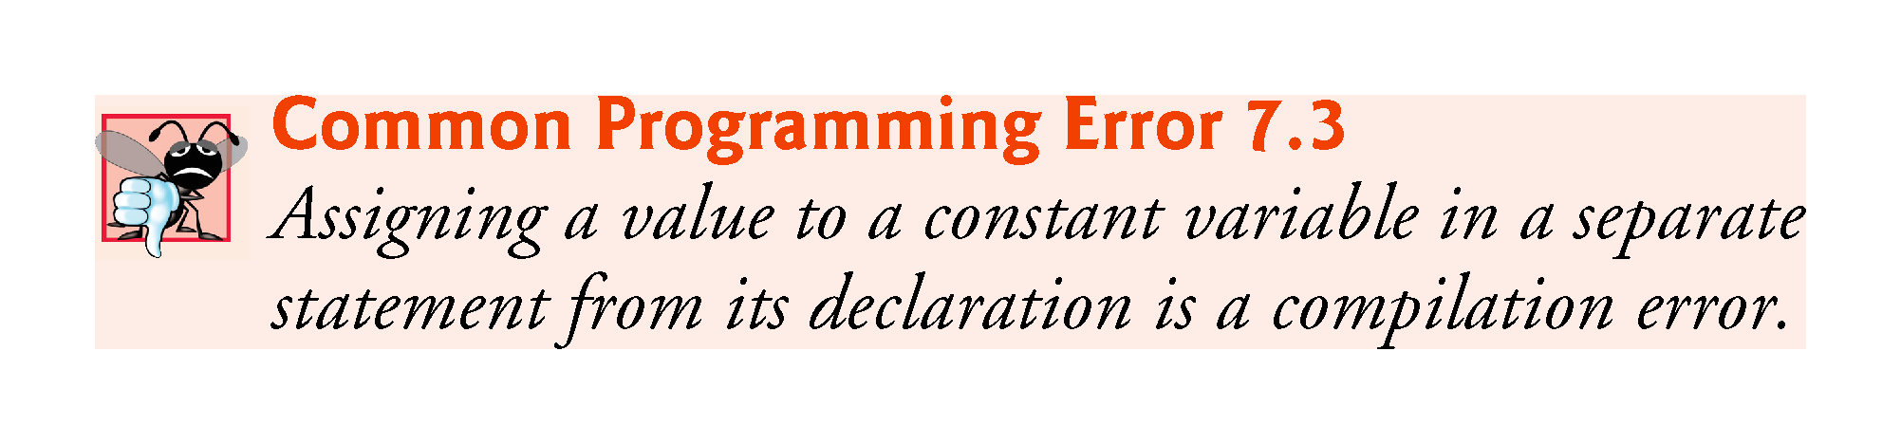

Slide 21
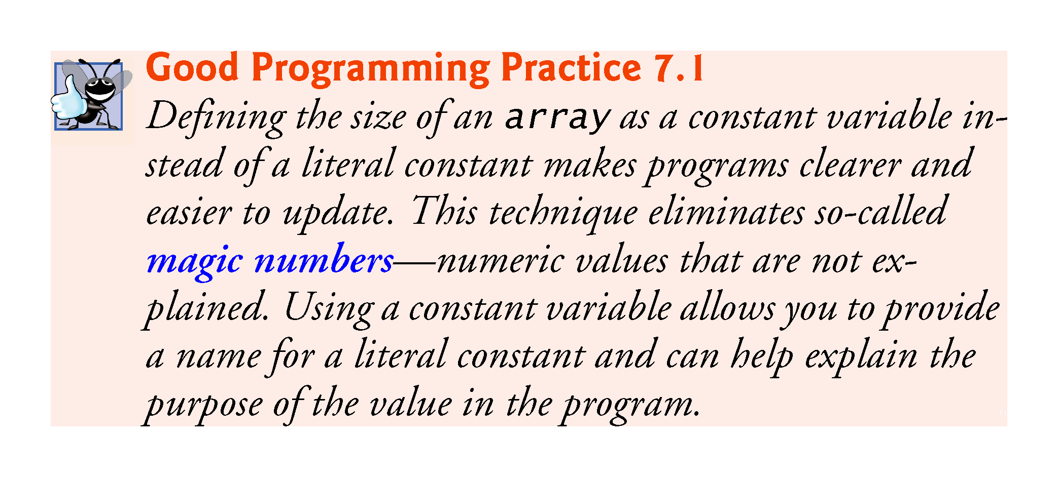

Slide 22
7.4.4 Summing the Elements of an array
Often, the elements of an array represent a series of values to be used in a calculation.
Fig. 7.6 sums the values contained in the four-element integer array a.

Slide 23
Exercises
Declare an array firstArray with 10 elements of type int. Initialize the i^{th} element to i² using a for loop. Remember that the length of the array can be found using firstArray.size(). Then print out the array using another for loop.
Declare an array secondArray with 6 elements of type int and initialize them to whatever you want using a list inside braces. Print out this array also.
Find the sum of the elements of firstArray and secondArray using a for loop.

Slide 24
